Slide 1
Service Recovery – How to Handle Complaints and Grievances
This information educates employees on Blessing Health System’s service expectations. It discusses situations when service recovery is appropriate and necessary and ways to effectively handle situations where customers are dissatisfied and steps to take toward service recovery.
11-17

Slide 2
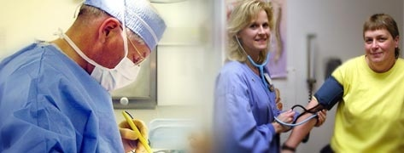
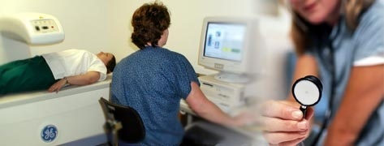
Introduction
What is Customer Service?
Customer service is:
Doing ordinary things extraordinarily well.
Going beyond what is expected.
Adding value and integrity to every interaction.
Being your best with every customer.
Discovering new ways to exceed the expectations of those you serve.
Surprising yourself with how much you can do.
Notes:
3

Slide 3
Introduction
Blessing Health System Values
Excellence - We will provide service excellence in meeting our customers' expectations.
We need to keep asking our customers what their expectations are and how well we are meeting them.
Notes:
4

Slide 4
Customer Focus
All of our efforts must have a customer focus, we need to:
Know who our customers are, and think beyond patients
Exceed customer expectations
Recognize the high cost of dissatisfaction
Notes:
5

Slide 5
Customer Focus
Customer Expectations
How well are we meeting our customer’s expectations?
Our customers have their own expectations about the quality of any given process or output.
Our customers’ definition of quality may differ from ours.
Quality is a multi-dimensional concept and it is sometimes difficult for people to know what constitutes quality.
They “know it when they see it.”
Notes:
6

Slide 6
Customer Focus
Who Are Our Customers?
Anyone who is the consumer of our goods or services.
Although patients may be our most obvious customers, it’s more than just the patients.
It also includes:
Physicians
Families of our patients
Other departments
Our own departmental coworkers
Partners (county health, nursing homes, other hospitals, etc.)
Suppliers of goods and services
Sometimes we are the customer when using BHS services.
When using any Blessing Health Care services:
ICARE Standards still apply
Treat those caring for us with the same respect we would give our customers

Slide 7
Patient Expectations
It is important for us to understand the patient’s perspective.
We will never know what we are doing well and what we could be doing better unless we ask the consumers of those services.
We learn valuable information from the interaction.
The act of having their opinion heard increases customer loyalty.

Slide 8
Patient Expectations
To effectively deal with customer, we need to understand their needs.
Our patient’s desire:
Control over their lives
To have their self-esteem preserved
To be treated fairly
Friendly welcome
To know what’s going on
A sense of security
Input into their care plan and/or treatment
Approval, acceptance and recognition
To feel important
To be appreciated
To feel a sense of belonging
To feel as if they are being dealt with honestly

Slide 9
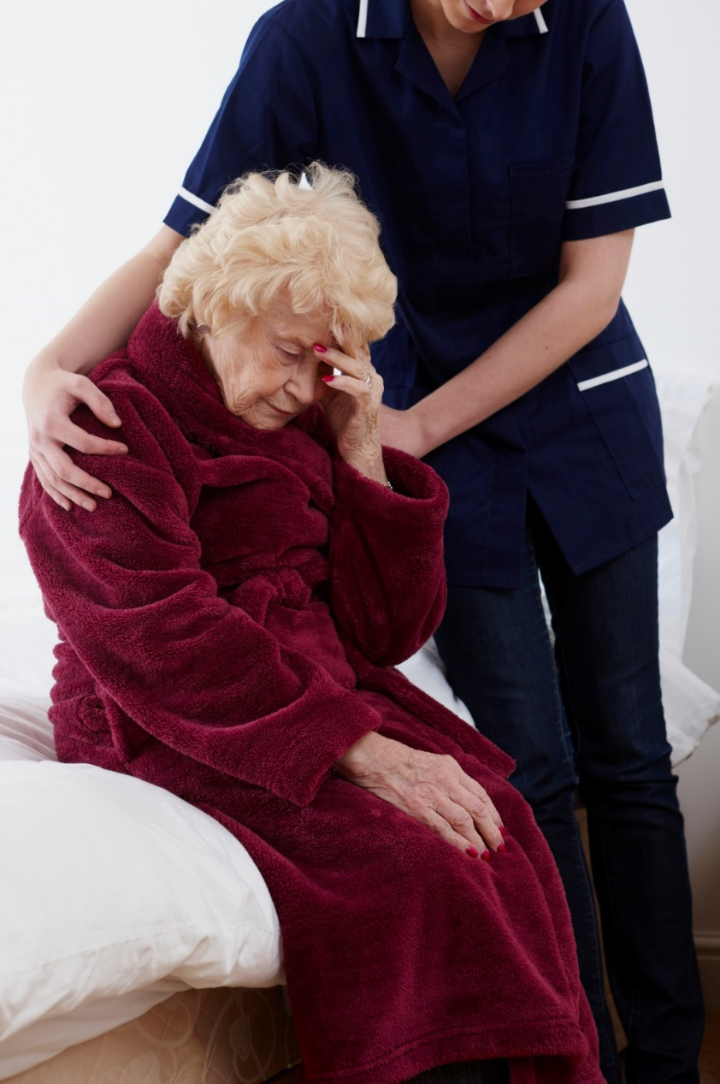
Handling Dissatisfaction
The cost of customer dissatisfaction is well documented:
90% or more of customers who are dissatisfied with the service they receive will not come back.
Each unhappy customer will tell his or her story to at least nine others.
68% of customers who stop doing business with an organization leave because of attitudes of indifference or lack of concern displayed by employees.
It’s five times more expensive to attract new customers than to keep an old one.

Slide 10
Handling Dissatisfaction
Why do you want customers to complain?
We learn valuable information from the interaction.
The act of complaining increases customer loyalty.
Customers whose complaints have been resolved tell five to six people.

Slide 11
Service Recovery
What is Service Recovery?
Service recovery is about making things right after something does not go as planned, with the hopes of regaining the patient/customer’s trust and loyalty.
It is important to recognize when a patient/customer’s expectations were not met, even if the patient/customer does not express his or her dissatisfaction.

Slide 12
Service Recovery
Who is Responsible?
All employees are responsible for identifying service recovery opportunities!
Patient/customer concerns with care or service may be identified:
When care or service is being provided
Complaints submitted using the complaint/grievance system
Information received from staff, volunteers or other disciplines
Responses/feedback to surveys, discharge phone calls, etc.
Direct phone calls, walk-ins, etc.

Slide 13
Service Recovery
Steps to Service Recovery
Upon recognition of a complaint or when a customer identifies a less than “very good” or ”excellent” service, use the ACT process:
A: Acknowledge, agree, and apologize
C: Correct, communicate empathy, and compensate
T: Take it forward, tie up the loose ends, tell the story, say “thank you”

Slide 14
Service Recovery
Steps to Service Recovery – The A Stands for:
Acknowledge the customer’s need:
Try to make them feel important.
Be sure to use AIDET so the person knows exactly who you are.
Agree that a problem occurred.
Apologize for the situation, not the act.
A sincere apology helps diffuse anger and dissatisfaction, and provides the opportunity to work together to find a solution.
In many cases, an apology may be enough.
Avoid excuses, but acknowledge that whatever happened caused them frustration, stress, etc.
A

Slide 15
Service Recovery
Steps to Service Recovery – The C Stands for:
Correct the situation to the best of your ability.
If the patient is in any danger, correct the situation immediately.
Communicate empathy, but don’t assign blame.
Compensate. After a sincere apology, determine if additional action is needed.
All employees are empowered to utilize service recovery by attempting to resolve the problem immediately.
It is okay to ask “How can I make it better for you?”
C

Slide 16
Service Recovery
Steps to Service Recovery
Sample corrections (solutions):
Apologize and offer information that helps the patient/customer understand what occurred.
Personally make contact with the appropriate staff member who can correct the situation.
C

Slide 17
Service Recovery
Steps to Service Recovery
Sample corrections (solutions):
Give a small token of apology (courtesy tickets to the Tea Room, Cafeteria, or gift cards to Walmart , Shopko, etc. in $5.00 and $10.00 amounts)
It may not rectify the problem, but offering something can help regain the patient/customer’s trust as it acknowledges our failure to meet their expectations.
Service Recovery Toolkits (purple folder) are in each department that may come in contact with external customers. These toolkits contain accepted tokens of apology, such as gift cards.
C

Slide 18
Service Recovery
Steps to Service Recovery – The T Stands for:
Take it forward. Contact the Hospice Director, RN or other member of the Hospice team
Tie up all loose ends.
Ask if there is anything else you can do for the patient/customer.
Tell the story, say “Thank you.”
When a customer complains, at least we have had an opportunity to recover the situation.
T

Slide 19
Service Recovery
It is important to track service recovery incidents so we can learn from them and prevent them from happening again.
Why did it happen?
What improvements can we make?
Did we recover the patient/customer?
This data is provided to managers.

Slide 20
High Severity Situations
How do I respond to a high severity situation?
Ensure the person is free from further harm.
Listen and acknowledge the customer’s concern.
Empathize but do not assign blame.
Accept responsibility, but do not make promises for the organization.
Report the incident immediately to the Hospice Director or another member of the Hospice team who will involve Risk Management.
Examples of high severity situations:
Anyone threatening to sue
Any written grievance
Any issue that requires administration-level interaction
Alleged wrongdoing or harm

Slide 21
Service Recovery Using Key Words
Patient Care Areas
PATIENT: “One of the Hospice people called me ‘sweetie’. I do not appreciate that.”
EMPLOYEE RESPONSE: “I am sorry and I apologize. I will remind him or her that you would prefer to be called by your name.”

Slide 22
Service Recovery Using Key Words
Billing
PATIENT: “I was told hospice would pay for my medicine. Now I have this bill.”
RESPONSE: “I’m sorry you received a bill for your medicines. I will contact the hospice office and let them know of your concern. Would you like be to do that while I am here in case they, or you, have other questions?

Slide 23
Service Recovery Using Key Words
Patient Access
PATIENT: “I keep getting asked the same question over and over. Don’t you people write things down?”
RESPONSE: “I’m sorry this is frustrating you. All of our staff want to verify your information to assure it is accurate – so they may ask the same questions that you’ve already answered. It’s one of the ways that we work to protect your safety and provide excellent care..

Slide 24
Service Recovery Using Key Words
Note
These scenarios do not represent all situations that might occur.
This is not a script that you need to learn. It is simply a guideline that you can follow to use the ACT (Acknowledge, Correct, Thank) framework.

Slide 25
Summary
Service recovery is about making things right after something does not go as planned, with the hopes of regaining the patient/customer’s trust and loyalty.
It is important to recognize when a patient/customer’s expectations were not met, even if the patient/customer does not express his or her dissatisfaction.
The ACT framework gives us the basic steps in recovery:
A: Acknowledge, agree, and apologize
C: Correct, communicate, and compensate
T: Take it forward, tie up all loose ends, tell the story, and say “thank you.”
If you would like more information about anything you have read in this CBL or to request additional tokens, please contact Blessing Hospice @ 217-228-5521.

