Slide 1
Emergency and Disaster Training
Volunteer training 2024

Slide 2
Emergency and Disaster Training
Learning Objectives:
Define an Emergency
Emergency Preparedness
Understand Volunteer Response to an Emergency
Hospital Codes

Slide 3
What is an Emergency??
Bomb Threat
Evacuation Plan
Fire
Mass Casualty
Armed Intruder
Snow Emergency
Suspicious Substance
Tornado
Other weather related emergencies
An emergency is any event that results in:
Disruption of the environment of care
Disruption of care, treatment, and services
Sudden, significantly changed or increased demands
for the hospice services

Slide 4
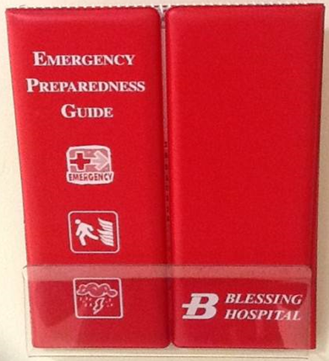
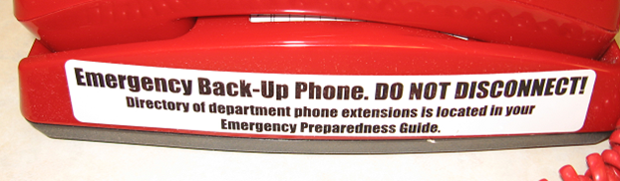
Emergency Operations Plan: Communications
Emergency Back-up Phones
During an internal telephone system downtime, a very minimized phone system will be available, using basic telephones. They are red and look like older style, non-display phones. Most departments will have one or two of these red emergency phones deployed
This emergency telephone system allows for internal dialing between red emergency phones, call transfers between emergency phones and out dialing
Refer to the instructions in your department’s Emergency Preparedness Guide

Slide 5
Hospice Emergency Preparedness
Blessing Hospice have a plan to ensure the necessary staff to deal with an emergency.
Blessing Hospice will work in unison with the health system and will work with the Hospital Command Center, if needed. Hospice has developed an Emergency Operations Plan to be used in the event of an emergency. When staff members receive information regarding an emergency, the plan is activated; the situation is evaluated and coordinated per the policy. All patients are prioritized according to established guidelines.
Notes:
There are policies and procedures in place to address emergencies, such as Bomb Threats, Severe Weather, Utility Interruptions, Telephone Interruptions, Fire Safety and Evacuation Plans.

Slide 6

Hospice Emergency Preparedness for Volunteers
Volunteers when visiting a patient’s home or nursing facility you should note the location of the exits and telephones
Identify anything that would inhibit your safety and that of the patient if an emergency would occur
Share concerns with Volunteer Coordinator or Hospice Director
Notes:
Emergency preparedness is discussed with families at time of admission.

Slide 7
Fire: In a Patient’s Home
R Remove Victim from immediate danger (If able)
A Alert others by dialing 911emergency contact number for area
C Contain fire by closing doors and windows. Turn off equipment. (If safe)
E Evacuate/Extinguish (Extinguish - if safe)
***Your safety is important! Please call the hospice office after calling and finding yourself safe.
R A C E

Slide 8
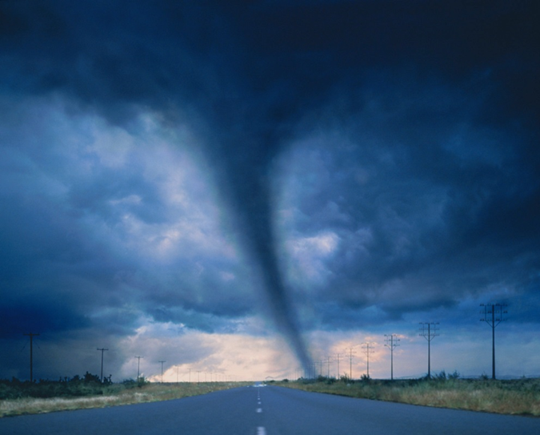
Tornado
Treat tornado-warning sirens the same as an announcement of a tornado warning over the radio
Note – tornado sirens are tested on the first Tuesday of each month at 10:00 a.m.

Slide 9
Weather Related Emergencies
Weather events that limit travel or disable utilities are determined to be one of the highest impact hazards for Hospice patients and staff members.
Listen to the radio if weather is questionable.
If in a car – Don’t attempt to flee in it. Abandon the vehicle and seek shelter in a public building or other safe area.
If in the office – Shelter in Place. Move away from windows, to an inside room and cover their head and neck for protection.
If volunteers are in a patient home- Shelter in Place. The Volunteer should assist the patient to a safe location and then seek protection for him or herself.
Once emergency has passed, call the Hospice Office.
Notes:
volunteers are in their cars during a severe thunderstorm warning or tornado warning, volunteers should listen to a local radio station for further information and instructions and immediately take cover. Close drapes, blinds or patient curtains, If practical, assist patient and self to windowless area in the center of building/home, Move patients dependent upon medical equipment away from windows, Offer blankets for face protection
Close room doors

Slide 10
Response After An Emergency
Hospice staff and volunteers are to follow any emergency orders form law enforcement or other local officials regarding the need to evacuate.
All patients will be contacted by phone to check patient’s status, if not accessible by phone, a staff member will be assigned to make a home visit if it is safe.
If in patients home or in route to patients home when an emergency occurs contact the hospice office and report location and status
Follow all instructions provided by Hospice staff
Notes:
Staff will not visit the home if an evacuation has been ordered or if the situation prevents safe access to patient’s home. This is explained during intake process.

Slide 11
Blessing Hospital Codes
Codes are organized into three major categories:
How is an Emergency Code Called?
Facility alerts
Fire Alarm, Suspicious Substance, Tornado Warning
Security alerts
Armed Intruder, De-escalation Team Activation, Infant/Child Abduction, Missing Person, Bomb Threat
Medical alerts
Mass Casualty Incident, Decontamination Team Activation, Code Blue (Cardiac/Respiratory Arrest)
The code should be called in a three-part statement by the operator to include:
Alert category (Facility/Security/Medical)
Specific code description
Location of emergency and other descriptor
Example: “Security Alert, Infant Abduction, 4th floor, Post Partum Unit,
newborn boy, blonde hair”
Additional information or instructions can be provided if known.

Slide 12
Blessing Hospital Codes
Condition Blue—Cardiac Arrest
If patient or family is around, stay calm.
Security Alert- De-Escalation—A Crisis Situation
Stay Calm. Allow staff to handle.
Security Alert- Infant/Child Abduction
Be Alert to someone leaving with a small child; inform security; do not intervene.
Security Alert- Fire Alarm
Dial 5555; stay calm, remove people from the area; turn off equipment, lights; use fire extinguisher; use RACER
Security Alert- Mass Causality
If family of victims comes to your area, stay calm. Send all families to Hospital Auditorium
Security Alert- Suspicious Substance
If you discover suspicious unidentified powder in the mail, or elsewhere, promptly wash your hands and report to a Blessing Staff Member.
Security Alert- Bomb Threat
Report a bomb threat immediately by dialing 5555. If a bomb threat has been received, all departments and public areas of the hospital must be searched.
Security Alert- Armed Intruder
If you observe, or recognize a dangerous situation, dial 5555. Be prepared to tell the location of the situation, the type of weapon, the number of suspects and hostages. If you hear the alert, attempt to exit. If you are unable to exit do your best to hide from the threat until the “All Clear” is given.
Medial Alert - Decontamination
This is a code for when a person is contaminated by hazardous materials.
Facility Alert – Tornado Warning
Overhead announcement or sirens. Move away from windows and doors- move to an enclosed windowless area if possible.

Slide 13
Questions
IF you have any questions, please call 217-223-8400 ext 4731 to talk with the Volunteer Coordinator.
Please complete Evaluation

