Slide 1
Infection Control
Volunteer Training 2024
Volunteer Training 2020

Slide 2
Infection control
LEARNING OBJECTIVES
Covid 19: Resources and Protocol
Learn the importance of handwashing and other health guidelines
Understand the guidelines to knowing when to stay home
Learn the best line of defense
Learn how to properly follow isolation procedures

Slide 3
Covid 19 Resources: https://www.cdc.gov/coronavirus/2019-nCoV/index.html

Slide 4
COVID-19: LEARN HOW TO PROTECT YOURSELF
WASH YOUR HANDS—Wash your hands with soap and water for at least 20 seconds after using the restroom, before eating, and when hands are visibly dirty. Use the towel to open the door, then dispose of the towel in the waste can. Use waterless hand sanitizers FREQUENTLY. Rub hands until dry.
AVOID TOUCHING YOUR FACE, NOSE, AND EYES—This is how germs are transmitted into your body.
WEAR A FACE MASK—All volunteers must wear a face covering while serving completing patient care. The face covering should reach above the nose, below the chin, and completely cover the mouth and nostrils. It should also fit snugly against the sides of the face. Face coverings are provided by hospice. Face coverings are available at all times per your request and at the beginning of each assignment.
SOCIAL DISTANCING—Practice social distancing by putting space between yourself and others. If possible, stay at least six feet (about two arms’ length from other people). Avoid large gatherings of people
CLEAN SURFACES—Clean and disinfect frequently used surfaces. While volunteering, wear gloves when using the sani-cloths in the purple container to clean phones, desktops, wheelchairs, etc.
AVOID CONTACT WITH ILL PEOPLE, AND STAY HOME IF YOU ARE SICK—Symptoms of COVID-19 include fever, cough, shortness of breath, loss of taste and smell, headache, fatigue, weakness, sneezing, watery eyes, and sinus pain not related to allergies. Please do not risk infecting others by coming to volunteer when you are ill. Call your program coordinator to let her know you cannot come in for your shift. If you think that you may have COVID-19—monitor your symptoms, avoid close contact with others, and call your doctor.
MANAGE YOUR STRESS—COVID-19 has certainly caused a lot of stress. Everyone reacts differently to stressful situations. You may feel anxious, mad, sad, or overwhelmed. Learn the common signs of stress, and make the time to unwind and do activities you enjoy—like volunteering! Talk with family and friends by phone, text, or email. If you or a loved one is feeling overwhelmed, there are hospital and CDC.gov support lines available.

Slide 5
COVID-19: LEARN HOW TO PROTECT YOURSELF
With each new assignment, the volunteer coordinator will identify when additional PPE outside of the mask is required.
Additional PPE may be required at our local long term care facilities. Please follow their procedures.
Complete the Covid 19 Screening questionnaire prior to arriving at your scheduled visit.

Slide 6
Handwashing
7 Steps To Clean Hands
https://www.youtube.com/watch?v=6JrEeR5OXiE-
Please view video

Slide 7
When To Wash Your Hands
Before and after your volunteer contact—use soap and water or gel/foam
Whenever hands become obviously soiled—use soap and water
Before eating, drinking, or handling food—use soap and water
After blowing your nose, covering a sneeze, or using the restroom—use soap and water
Before and after physical contact with a patient—use gel/foam
Wearing gloves does not replace hand hygiene

Slide 8
Instructions For Washing Your Hands With Soap And Water
Apply soap to hands and make a good lather.
Work lather into all parts of the hands and up to the wrists.
Wash hands with soap for 15 seconds for ordinary contacts.
Pay careful attention to areas around and under the nails and in-between the fingers.
Rinse hands—let water run until you can turn off faucet with a paper towel.
Dry hands well with paper towels or under hand dryer.
Turn off water with a paper towel. Faucets are considered contaminated.
Use only hospital-approved lotions (available from Volunteer Services) if skin is dry—and you are working with patients and/or patient equipment.

Slide 9
Your Best Line Of Defense
Hand washing
Your own skin. Make sure to take care of yours.
Breaks, sores, or rashes all create openings in your best defense; your skin.
Bandage or cover open areas when volunteering.

Slide 10
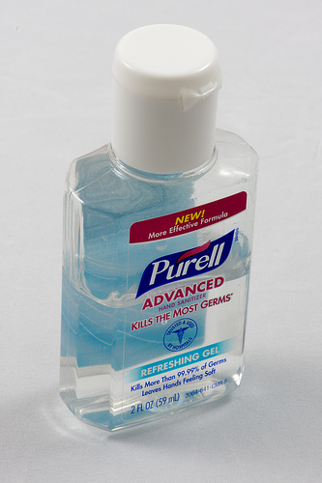
Handwashing With Foam Or Alcohol Rub
Preferred and most effective method if hands are not soiled.
Apply product to one hand using amount recommended by manufacturer
Rub hands together covering all surfaces of the hands and fingers, focusing on the fingertips and fingernails , until hands are dry
Notes:
IF you need hand sanitizer ask for it

Slide 11
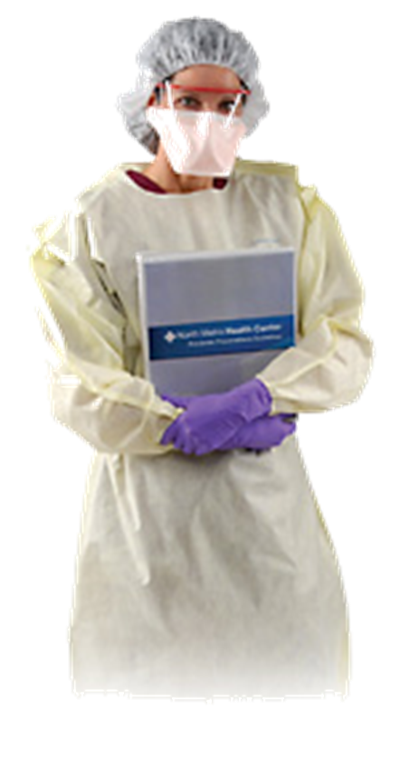
Preventative Measures
Standard Precautions assume that areas of the body have germs which, if transmitted to others, could cause disease.
These areas include mucous membranes, moist areas of body, broken skin, anything wet coming from the body, and any medical devices that drain fluids from the body.
The intent of Standard Precautions is to protect healthcare workers and patients from disease causing germs.
Standard Precautions do not protect against airborne diseases.

Slide 12
Transmission-Based precautions
For patients who may have infections that are highly contagious.
They are used in addition to standard precautions.
Use the appropriate equipment when entering a patient's room in isolation by following the guidelines on the isolation signs.
Personal Protective Equipment (PPE) including gloves, gowns, and masks.

Slide 13
Transmissions-Based Precautions: Protective
Does not require personal protective equipment
Does restrict staff or visitors with any signs of illness (colds or other minor infections).

Slide 14
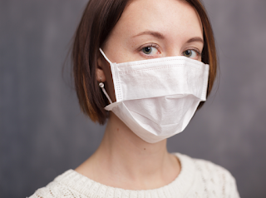
Transmissions-Based Precautions: Contact Precautions
Used for MRSA, VRE, RSV, chickenpox, shingles, lice, C. difficile diarrhea or any uncontrolled drainage.
Wear gloves and a gown whenever entering the room
Remove them and wash your hands before leaving the room.
Always use dedicated patient equipment (stethoscope, thermometer, etc.) or immediately decontaminate the equipment after use.

Slide 15
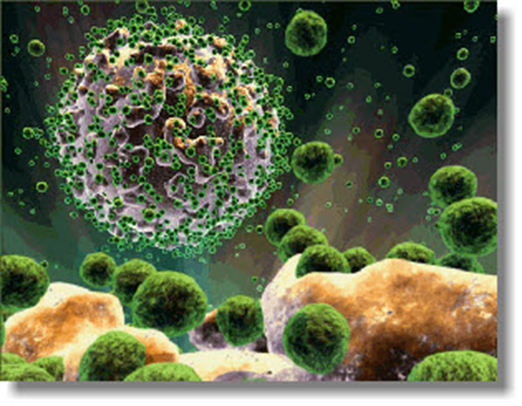
Transmissions-Based Precautions: Multi-drug Resistant
Isolation precautions used for patients infected or colonized with MRSA, VRE, or resistant gram-negative infections.
Wear gloves to enter the room. Wear a gown for direct contact with the patient or contaminated items.
Wear a mask if the patient has a resistant organism in the respiratory tract.
Remove gloves and perform hand hygiene before leaving. Use dedicated equipment (stethoscope, thermometer, BP cuff).
Clean and disinfect any common equipment (wheelchair, scale, x-ray machine) after use when removing from the room.

Slide 16
Transmissions-Based Precautions: Droplet
Precautions are used for meningitis, pertussis, influenza, mycoplasma, and adenoviral diseases.
Wear a standard isolation mask for patient care.

Slide 17
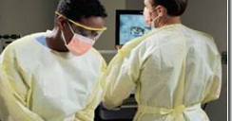
Transmissions-Based Precautions: High Risk Isolation
Emerging infectious diseases that have newly appeared in a population or is rapidly increasing in incidence and requires immediate and extensive control measures to limit morbidity and mortality.
Staff entering the high risk isolation rooms are required to complete training competency evaluations in high risk precautions, and use of and removal of PPE including but not limited to:
Double gloves
Impervious disposable isolation gowns or suits
Disposable full face shields
Masks
N95 or PAPR respirators
Head/hair covers
Disposable shoe or boot covers
Information on High Risk Isolation can be found on the BRAIN under Resources, Emergency Preparedness.

Slide 18
PPE: Personal Protective Equipment

Slide 19
PPE-gloves
Put on clean gloves before touching any patient's mucous membranes or non-intact skin.
When performing several invasive procedures on same patient, change gloves between each procedure to prevent contaminating another:
Body part
Piece of equipment
Environmental surface
Wear gloves any time you have contact with blood or other body fluids (when you treat an open wound, draw blood, or handle dirty laundry).
A WORD OF CAUTION
Remember that wearing gloves does NOT replace hand hygiene, the most basic element of infection control.
Gloves may be perforated during use and bacteria may multiply rapidly on gloved hands.

Slide 20
PPE Masks
Wear a mask that covers your nose and mouth as well as goggles or a face shield when you are performing a procedure that may create splashes or sprays of blood or whenever you handle body fluids (for example, procedures involving Foley catheters, suction canisters, etc.)
Wear a surgical mask for protection against infectious large-particle droplets (for example, from coughing or sneezing).
Surgical masks are not an adequate substitute for respirators when treating tuberculosis, measles, disseminated herpes zoster, SARS or chickenpox patients.

Slide 21
PPE-Gowns
Wear a gown when your clothing could be soiled with blood or other body fluids.
Choose the correct gown for your purpose (i.e., fluid resistant).
Use correct technique when removing the gown.
Sometimes gowns are worn to keep from transmitting pathogens from a patient's room to another area of the hospital.
Always remove gown before leaving patient's room and perform hand hygiene with soap and water or alcohol products.

Slide 22
Sequence for putting on PPE
Gown
There are 2 sizes of the 3 hole isolation gowns:
Gray collar fits most Green collar is XXXL
The gown wraps around, there are no ties
Should fully cover torso front & back from the neck to knees, arms to ends of wrists
2. Mask or Respirator
Secure ties or elastic bands at middle of head and neck
Fit flexible band to nose bridge
Fit snug to face and below chin
Fit check respirator
3. Goggles or Face Shield
Place over face and eyes and adjust to fit
4. Gloves
Extend to cover wrist of isolation gown

Slide 23
Sequence for removing PPE
1. Gloves - outside of gloves are contaminated!
Grasp outside of glove with opposite hand and peel off
Hold removed glove in gloved hand
Slide fingers of ungloved hand under remaining glove at wrist
Peel glove off over first glove
Discard in waist container
2. Goggles or face shield-outside of goggles or face shield is contaminated!
To remove, handle by head band or ear pieces
Place in designated receptacle for reprocessing or in waste container
3. Gown - front and sleeves are contaminated!
Pull away from neck and shoulders, touching inside of gown only
Turn inside out
Fold or roll into a bundle and discard
Do not remove your gloves and leave inside the gown
4. Mask or respirator-front of mask/respirator is contaminated! DO NOT TOUCH!
Grasp bottom, then the top ties or elastics and remove
Discard in waste container
5. Hand hygiene

Slide 24
Stop the Spread: When To Stay Home

Slide 25
When should I call in sick
Conjunctivitis (pink-eye)
Fever over 100 degrees Fahrenheit.
Acute respiratory illness or bacterial infection of the throat (such as strep throat, mumps, influenza, pneumonia, pertussis). Volunteers who have influenza should stay off duty until they have been fever free for at least 24 hours. They should not enter Protective Isolation rooms until they have been fever free for seven days.
Cough lasting longer than seven days.
Draining skin wound or rash
Gastroenteritis (diarrhea more than 4 times per day)
Head lice or scabies
Hepatitis A
Measles
Chickenpox (varicella)
Covid 19
This is a reminder that volunteers should follow the same communicable disease precautions as employees.
The Blessing Human Resources Policy on Communicable Disease Regulations states that persons with these symptoms will be restricted from duty:

Slide 26
Influenza: An Ounce of Prevention
The following steps help to prevent the spread of respiratory illnesses such as the flu:
Cough into your shoulder or sleeve if possible—If you cover your nose or mouth with a tissue when you cough or sneeze—be sure to dispose of the tissue. Follow up with proper hand hygiene.
Wash your hands often with a 15 second soap and water hand wash, or use an alcohol-based hand cleaner (foam or gel). This is important especially after you cough or sneeze.
Avoid close contact with people who are sick. When you are sick, keep your distance from others to protect them from getting sick too.
Try not to touch your eyes, nose, or mouth. Germs often spread this way.
If you get the flu, stay home. In this way you will help prevent others from catching your illness.
The single best way to protect yourself and others against influenza is to get a flu vaccination each year.
The flu vaccine will be available at no cost at the hospital every fall.
Flu shots are mandatory for BHS staff and volunteers.
Volunteers who decline the flu shot will need to wear a mask in the event a flu outbreak is declared.

Slide 27
Additional Thoughts
For the most part, volunteers will not have direct contact with blood borne pathogens or bodily fluids with one exception; you may share a person’s hand. Also secondary contact would be touching exposed surfaces.
Always consider when you meet with a patient you may not touch anything, but you may have laid your purse down or bag, an/or your shoes may have come in contact with a contaminate.
Always check with the Volunteer Coordinator to see if any safety precautions are needed.

Slide 28
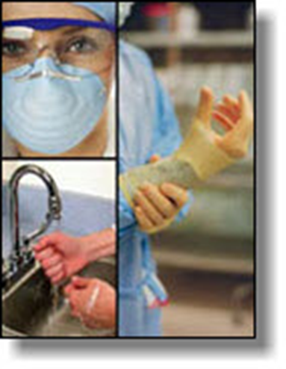
Summary
Frequent hand hygiene is the foundation of infection control.
Be familiar with key elements of the infection control program.
Use good workplace practices and follow Standard Precautions.
Wear PPE and use respiratory protection as indicated.
Receive the hepatitis B vaccination and other vaccinations when they are offered.
The first step to prevent MRSA, is to prevent healthcare infections in general.
If you are exposed to blood or other potentially infectious materials wash the area for 10-15 minutes with water and contact your Hospice immediately.
For more information, call the Infection Prevention staff.

Slide 29
Please call the Volunteer Coordinator or their designee if you have any questions.
Thank you for your dedication to Blessing Hospice, patients and families.
Please follow all CDC recommendations, follow the Blessing Healthy System Website and stay Safe.
Please remember to fill out the evaluation and submit.

