Slide 1
Patient’s Rights and HIPPA: Unique Needs of Dying Patients, Families, & Caregivers
At the end of life, patients have the right to physical and psychological comfort.
Volunteer Training 2024
Revised November 2017

Slide 2
Objectives
This program provides employees with information so they are able to:
Recognize the unique needs of patients/families to determine the quality of end of life care
Be knowledgeable about patient rights
Describe what is PHI under HIPAA
Be part of the team in ensuring rights are followed
Know when and who to report a concern too

Slide 3
Quality End of Life Care
Quality end of life care includes:
Physical comfort
Emotional support
Promoting shared decision-making
Treating the person with respect
Providing information and emotional support to family members
Coordinating care across settings
Accepting patient/family autonomy to make decisions appropriate for them
This Photo by Unknown Author is licensed under CC BY

Slide 4
Please Review The Hospice Patient And Caregiver Rights And Responsibilities Form and Privacy Rights On This Website. All Patients Are Provided This Information At Time Of Admission

Slide 5
Highlights Of Hospice Patient And Caregiver Rights And Responsibilities
Autonomy and Choice
In order to make autonomous, informed choices, patients and families have the right to:
Be informed about their condition, treatment options, and outcomes
Spend the rest of their life as they choose
One of a dying patient’s and family’s greatest concerns is the fear of loss of control.
There is an ongoing need to provide the patient with opportunities for:
Choice
Input
Informed decision making
Dying patients have the right to be in control of their life and their death.

Slide 6
Highlights Of Hospice Patient And Caregiver Rights And Responsibilities
Communication Skills and Strategies
Provide information at a level that is understandable to the patient.
Use of open ended questions are most effective:
"What is most important to you?"
"What relationships are most important to you?”
Allow the patient and family to do a "Life Review“.
This provides a reflection on their life and the contributions they have made, as well as resolving any unresolved issues.
"Life Review" is very healing, as we celebrate life and bring closure.
Provide information in small intervals for the patient to hear and allow them to process.

Slide 7
Highlights Of Hospice Patient And Caregiver Rights And Responsibilities
Rights To Be Free From Abuse, Neglect And Exploitation
Receive care in a safe environment and be protected from abuse, neglect and harassment.
Have abuse, neglect or harassment investigated.
Be treated in a respectful and dignified manner regardless of their race, age, sexual orientation, gender expression, gender identity, disability, cultural, psychosocial or spiritual values.
Access protective and advocacy services.
Advocacy Services are agencies or groups of people organized around specific populations or diseases that provide assistance, support and resources
Protective Services are agencies funded by public funds to investigate and look after vulnerable populations.
Be free from any form of restraints and seclusion that are NOT medically necessary or needed to prevent harm to self or to others.
Restraints and seclusion are not to be used as a means of coercion, discipline, convenience or retaliation.

Slide 8
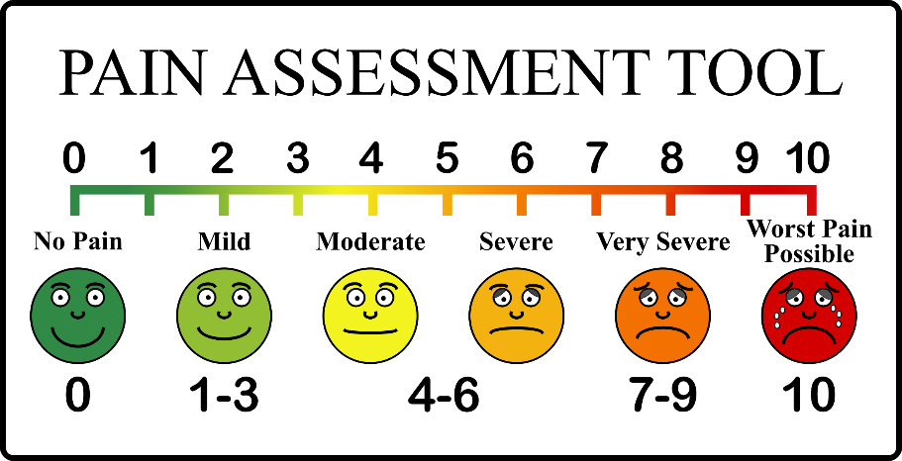
Highlights Of Hospice Patient And Caregiver Rights And Responsibilities
Patients have the right to a appropriate assessment and management of pain.
Blessing Hospital provides language access services that enable patients with limited English proficiency (LEP), impaired hearing or other sensory impairments to participate actively in care, from admission through discharge, by the provision of language services, which allow successful exchange of information between patients and healthcare providers.
Patients are assessed, provided interventions and re-assessed to ensure the interventions were effective.
Education regarding pain management.
Rights to Pain Management

Slide 9
Highlights Of Hospice Patient And Caregiver Rights And Responsibilities
Rights To Privacy: HIPAA
Rights To Voice Grievances and other Rights
•Any unique identifying number or code To have their personal health information (PHI) kept confidential.
This information includes but not limited too: •Names •Dates, except year •Telephone numbers •Geographic data •FAX numbers •Social Security numbers •Email addresses •Medical record numbers •Medical information Account numbers •Health plan beneficiary numbers •Full face photos and comparable images
Voice Grievances without worrying about retribution
Filming: Consent is required prior to filming or recording patients for purposes other than identification, diagnosis or treatment. Filming and Recording refers to photographic, video, electronic or audio media. This would include any pictures taken by visitors and “selfies.” Avoid having unintended pictures taken of our patients.

Slide 10
How to report a concern:
Please report and concerns, as soon as possible.
Please contact the Volunteer Coordinator or the Hospice Director at 217-228-5521 or toll free at 877-672-7610.
If you are unable to resolve your concerns in this manner, you may contact the Illinois Department of Public Health, Division of Health Care Facilities and Programs at 800-252-4343 (TYY, hearing impaired use 800-547-0466), 525 W. Jefferson St., Springfield, IL62761-0001 or the Accreditation Commission for Health Care (ACHC) at 855-937-2242 or ttps://www.achc.org/complaint-policy-process.html. For discrimination, a patient may lodge a grievance with the Illinois Department of Human Rights.

Slide 11
References
Clinical policy – Care of Patient at the End of Life
Clinical policy – Palliative Care Services, Screening, and Referral
JCAHO Standard
End-of-Life Nursing Education Consortium Curriculum
National Consensus Project. (2004) Clinical Practice Guidelines for Quality Palliative Care
Clinical Practice Guidelines
National Hospice and Palliative Care Organization www.nhpco.org
Center to Advance Palliative Care www.capc.org
Growthhouse www.growthhouse.org
Comfort Care (Adult) Order Set

Slide 12
Thanks!
Remember to complete your evaluation!
If you have any questions, please contact Cindy Grawe, Volunteer Coordinator.
Phone: 217-223-8400 ext. 4731 or email
Cindy.Grawe@blessinghealth.org

